Slide 1
CIS CONTROL 11: SECURE CONFIG FOR NETWORK DEVICES
SECURE CONFIGURATION FOR NETWORK DEVICES SUCH AS FIREWALLS, ROUTERS, AND SWITCHES

Slide 2
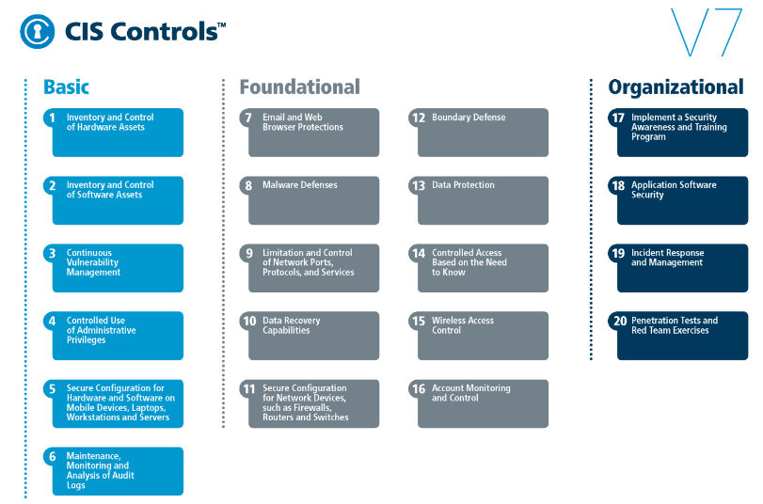
CIS CONTROL 11: SECURE CONFIG FOR NETWORK DEVICES
https://www.cisecurity.org/controls/

Slide 3
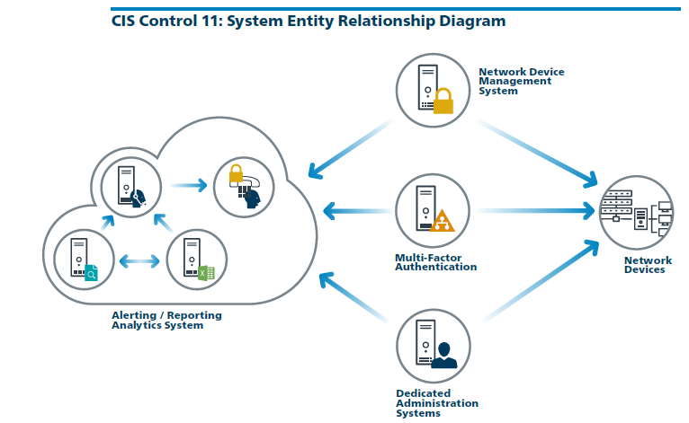
CIS CONTROL 11: SECURE CONFIG FOR NETWORK DEVICES
https://www.cisecurity.org/controls/

Slide 4
CIS CONTROL 11: SECURE CONFIG FOR NETWORK DEVICES
11.1: Maintain Standard Security Configurations for Network Devices
Maintain standard, documented security configuration standards for all authorized network devices.

Slide 5
CIS CONTROL 11: SECURE CONFIG FOR NETWORK DEVICES
11.2: Document Traffic Configuration Rules
All configuration rules that allow traffic to flow through network devices should be documented in a configuration management system with a specific business reason for each rule,

Slide 6
CIS CONTROL 11: SECURE CONFIG FOR NETWORK DEVICES
11.2: Document Traffic Configuration Rules
…a specific individual’s name responsible for that business need, and an expected duration of the need.

Slide 7
CIS CONTROL 11: SECURE CONFIG FOR NETWORK DEVICES
11.3: Use Automated Tools to Verify Standard Device Configurations and Detect Changes
Compare all network device configuration against approved security configurations defined for each network device in use and alert when any deviation is discovered

Slide 8
CIS CONTROL 11: SECURE CONFIG FOR NETWORK DEVICES
11.4: Install the Latest Stable Version of Any Security-related Updates on All Network Devices
Install the latest stable version of any security-related updates on all network devices.
END

